Slide 1

Python Functions
by Su Lee Seng,
Jan, 2021

Slide 2

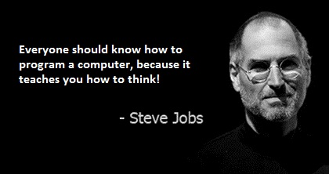
Python Programming
(Business & Analytics)
by Su Lee Seng,
Jan, 2021

Slide 3
Talk is cheap.
show me the code.

Slide 4
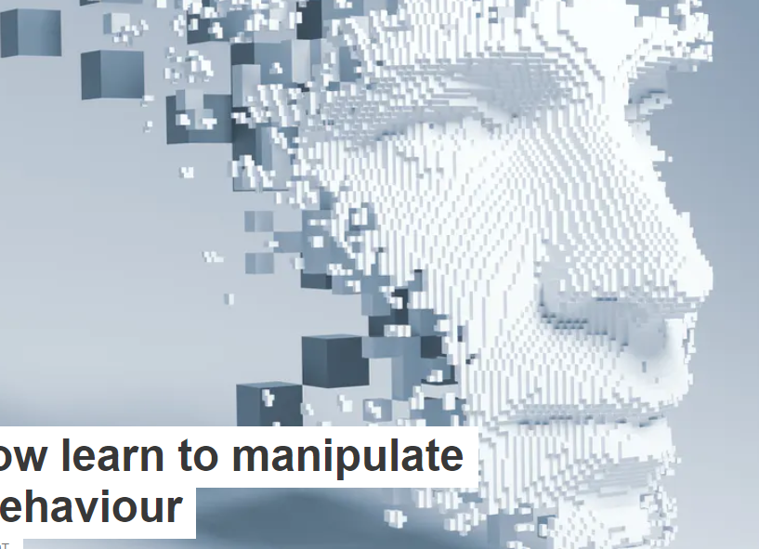
AI :
An Introduction
Python :
Python Functions
(( Please, scan QR code for attendance. ))

Slide 5

Python Functions :
Recall : Random Numbers
uniform()
The uniform() function of the random module takes starting and ending values of a range as arguments and returns a floating-point random number in the range [starting, ending]:
print('Random Number in range(2,8)=>', random.uniform(2,8))

Slide 6

Python Functions :
Recall : Random Numbers
randint()
This function is similar to the uniform() function. The only difference is that the uniform() function returns floating-point random numbers, and the randint() function returns an integer. It also returns the number in the range [starting, ending]:
print('Random Number in a range(2,8)=>', random.randint(2,8))

Slide 7
Python Functions
What is a function ?

Slide 8
Python Functions :
What is a function ?
In Python functions are groups of related statements that can be called together, that typically perform a specific task, and which may or may not take a set of parameters or return a value.
Functions can be defined in one place and called or invoked in another. This helps to make code more modular and easier to understand.
It also means that the same function can be called multiple times or in multiple locations. This help to ensure that although a piece of functionality is used in multiple places; it is only defined once and only needs to be maintained and tested in one location.

Slide 9
Python Functions :
What is a function ?
When a function is called (or invoked) the flow of control a program jumps from where the function was called to the point where the function was defined. The body of the function is then executed before control returns back to where it was called from.
As part of this process, all the values that were in place when the function was called, are stored away (on something called the stack) so that if the function defines its own versions, they do not overwrite each other.

Slide 10
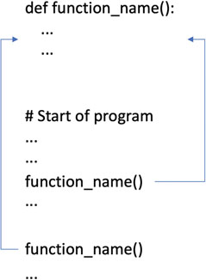
Python Functions :
What is a function ?
The invocation of a function illustrated below:
Each time the call is made to function_name() the program flow jumps to the body of the function and executes the statements there.
Once the function finishes it returns to the point at which the function was called.

Slide 11
Python Functions :
Types of Functions
Technically speaking there are two types of functions in Python; built-in functions and user-defined functions.
Built-in functions are those provided by the language and we have seen several of these already. For example, both print() and input() are built-in functions. We did not need to define them ourselves as they are provided by Python.
In contrast user-defined functions are those written by developers. We will be defining user-defined functions and it is likely that in many cases, most of the programs that you will write will include user-defined functions of one sort or another.

Slide 12
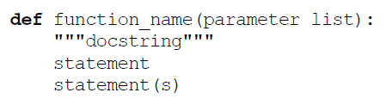
Python Functions :
Defining Functions
The basic syntax of a function is illustrated below:
This illustrates several things:
1. All (named) functions are defined using the keyword def; this indicates the start of a function definition. A keyword is a part of the syntax of the Python language and cannot be redefined and is not a function.

Slide 13
Python Functions :
Defining Functions
.
2. A function can have a name which uniquely identifies it; you can also have anonymous functions, but we will leave those until later in this chapter.
3. The naming conventions that we have been adopting for variables also applies to functions, they are all lower case with the different elements of the function name separated by an '_'.
4. A function can (optionally) have a list of parameters which allow data to be passed into the function. These are optional as not all functions need to be supplied with parameters.

Slide 14
Python Functions :
Defining Functions
5. A colon is used to mark the end of the function header and the start of the function body. The function header defines the signature of the function (what its called and the parameters it takes). The function body defines what the function does.
6. An optional documentation string (the docstring) can be provided that describes what the function does. We typically use the triple double quote string format as this allows the documentation string to go over multiple lines if required.

Slide 15
Python Functions :
Defining Functions
7. One or more Python statements make up the function body. These are indented relative to the function definition. All lines that are indented are part of the function until a line which is intended at the same level as the def line.
8. It is common to use 4 spaces (not a tab) to determine how much to indent the body of a function by.

Slide 16
Python Functions :
An example Function
The following is one of the simplest functions you can write; it takes no parameters and has only a single statement that prints out the message 'Hello World':
def print_msg():
print('Hello World!')
# MAIN program
print_msg()
Will generate the output
Hello World!

Slide 17
Python Functions :
An example Function
Be careful to include the round brackets () when you call the function. This is because if you just use the function’s name then you are merely referring to the location in memory where the function is stored, and you are not invoking it.
We could modify the function to make it a little more general and reusable by providing a parameter. This parameter could be used to supply the message to be printed out, for example:
def print_my_msg(msg):
print(msg)
# MAIN program
Print_my_msg(“Hello there”)

Slide 18
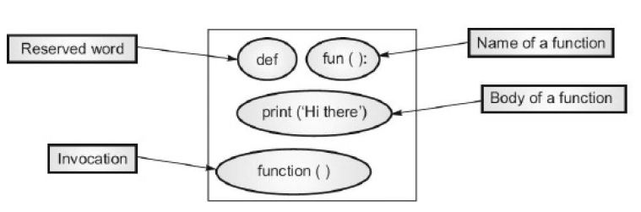
Python Functions :
An example Function
def print_msg():
print('Hello World!')
print_msg()

Slide 19
Python Functions :
An example Function
This now means that we can call the print_my_msg function with a variety of different messages:
def print_msg():
print('Hello World!')
print_msg()
-------------------------------------------------------------------------------+
def print_my_msg(msg):
print(msg)
print_my_msg('Hello World')
print_my_msg('Good day')
print_my_msg('Welcome')
print_my_msg('Ola')
Output :
Hello World
Good day
Welcome
Ola

Slide 20
Python Functions :
Naming conventions for functions
Function naming conventions are similar to variable naming conventions (and are also found in the PEP 8 document). Function names should:
  • be lowercase
  • have_an_underscore_between_words
  • not start with numbers
  • not override built-ins
  • not be a keyword

Slide 21
Python Functions
The return Statement

Slide 22
Python Functions :
Returning Values from Functions (return statement)
It is very common to want to return a value from a function. In Python this can be done using the return statement. Whenever a return statement is encountered within a function then that function will terminate and return any values following the return keyword.
This means that if a value is provided, then it will be made available to any calling code.
For example, the following defines a simple function that squares whatever value has been passed to it:
def square(n):
return n * n
A function that does not return a value is commonly known as a void function in programming terminology.

Slide 23
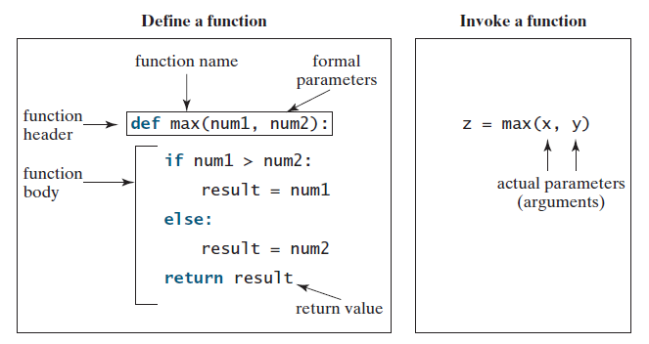
New slide.
Python Functions :
An example Function
def print_msg():
print('Hello World!')
print_msg()
#MAIN program.

Slide 24
Python Functions :
The return Statement
The return statement has two purposes: it ends the function's execution, and it can optionally provide the result value for the function. The return statement is optional. This leads to three use cases:
  No return statement: The function finishes at the end of the suite of statements. The return value is None.
  A return statement with no expression: The function finishes when the return statement is executed, the result is None.
  A return statement with an expression: The function finishes when the return statement is executed, the value of the expression is the result. A return statement with a list of expressions creates a tuple, suitable for multiple assignment.

Slide 25
New slide.
Python Functions :
An example Function
# Return the max of 2 no.
def max(num1, num2):
if num1 > num2:
result = num1
else:
result = num2
return result
# MAIN program
i = 5
j = 20
# Call the max function
k = max(i, j)
print("The larger number of ", i, " and ", j, " is ", k)

Slide 26
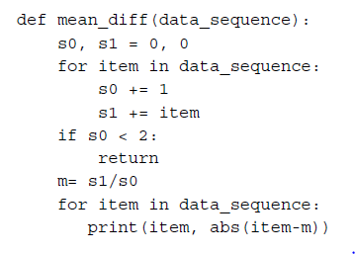
Python Functions :
The return Statement
It's common to use a return statement to finish early when an exception condition has been met, otherwise you execute the rest of the suite of statements in the function definition. It looks like this:

Slide 27
Python Functions :
Returning Values from Functions
When we call this function, it will multiple whatever it is given by itself and then return that value.
# Store result from square in a variable
result = square( 4)
print(result)
# Send the result from square immediately to another function
print(square( 5))
# Use the result returned from square in a conditional
#expression
if square(3) < 15:
print(' Still less than 15 ')
Output :
16
25
Still less than 15

Slide 28
Python Functions :
Returning Values from Functions
It is also possible to return multiple values from a function, for example in this swap function the order in which the parameters are supplied is swapped when they are returned:
def swap(a, b):
return b, a
# MAIN program
a = 2
b = 3
x, y = swap(a, b)
print(x, ',', y)
Output :
3 , 2

Slide 29
Python Functions :
Returning Values from Functions - Example
def minimum(a,b):
if a<b:
return a
elif b<a:
return b
else:
return “Both the numbers are equal”
# MAIN program
print(minimum(100,85))
Output :
85 is minimum

Slide 30
Python Functions :
Returning Values from Functions
In actual fact the result returned from the swap function is what is called a tuple which is a simple way to grouping data together. This means that we could also have written:
z = swap(a, b)
print(z)
Output :
3 , 2

Slide 31
New slide.
Python Functions :
Call Stacks
Each time a function is invoked, the system creates an activation record that stores its arguments and variables for the function and places the activation record in an area of memory known as a call stack.
A call stack is also known as an execution stack, runtime stack, or machine stack, and is often shortened to just “the stack.”
When a function calls another function, the caller’s activation record is kept intact and a new activation record is created for the new function call.

Slide 32
New slide.
Python Functions :
Call Stacks
When a function finishes its work and returns control to its caller, its activation record is removed from the call stack.
A call stack stores the activation records in a last-in, first-out fashion. The activation record for the function that is invoked last is removed first from the stack.
Suppose function m1 calls function m2, and then m3. The runtime system pushes m1’s activation record into the stack, then m2’s, and then m3’s. After m3 is finished, its activation record is removed from the stack.
After m2 is finished, its activation record is removed from the stack. After m1 is finished, its activation record is removed from the stack.

Slide 33
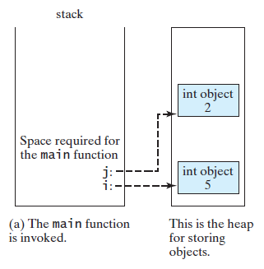
New slide.
Python Functions :
Call Stacks
When a function is invoked, an activation record is created to store variables in the function.
The activation record is released after the function is finished.

Slide 34
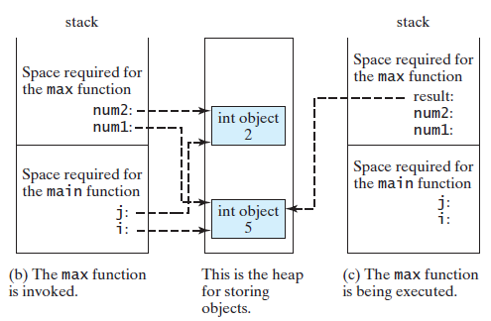
New slide.
Python Functions :
Call Stacks
xxx

Slide 35
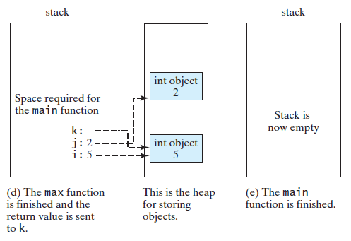
New slide.
Python Functions :
Call Stacks
xxx

Slide 36
New slide.
Python Functions :
Void Function or None Function
Technically, every function in Python returns a value whether you use return or not. If a function does not return a value, by default, it returns a special value None.
For this reason, a function that does not return a value is also called a None function. The None value can be assigned to a variable to indicate that the variable does not reference any object.
For example, if you run the following program:
    def sum(number1, number2):
    total = number1 + number2
    print(sum(1, 2))
you will see the output is None, because the sum function does not have a return statement. By default, it returns None.

Slide 37
Python Functions
Pass By Value

Slide 38
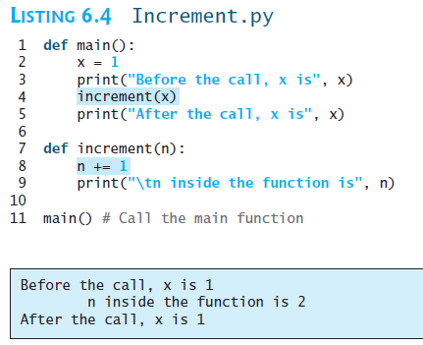
New slide.
Python Functions :
Pass by Value
When you invoke a function with arguments, each argument's reference is passed by
value to the parameter in the function.
Notes:
Because all data are objects in Python, a variable for an object is actually a reference to the
object. When you invoke a function with arguments, the reference value of each argument is
passed to the parameter. This is referred to as pass-by-value in programming terminology. For
simplicity, we say that the value of an argument is passed to a parameter when invoking a
function. The value is actually a reference value to the object.

Slide 39
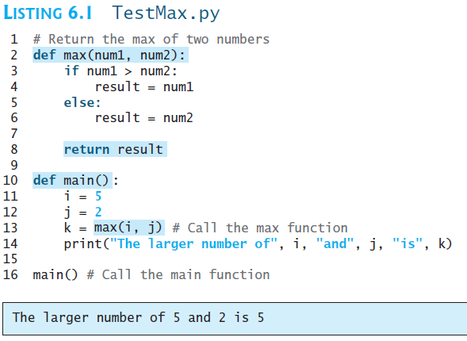
New slide.
Python Functions :
An example Function
xxx

Slide 40
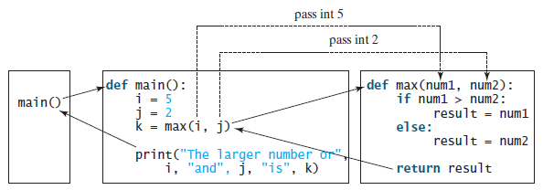
New slide.
Python Functions :
An example Function
When a function is invoked, the control is transferred to the function. When the function is finished, the control is returned to where the function was called.

Slide 41
New slide.
Python Functions :
An example Function
The execution of the main function begins in line 11. It assigns 5 to i and 2 to j (lines 11–12) and then invokes max(i, j) (line 13).
When the max function is invoked (line 13), variable i’s value is passed to num1 and variable j’s value is passed to num2. The control is transferred to the max function, and the max function is executed. When the return statement in the max function is executed, the max function returns the control to its caller (in this case the caller is the main function).
After the max function is finished, the returned value from the max function is assigned to k (line 13). The main function prints the result (line 14). The main function is now finished, and it returns the control to its caller (line 16). The program is now finished.

Slide 42
Python Functions
Parameters

Slide 43
Python Functions :
Function Parameters
Parameters are defined as part of the function header and the data passed into the function :
• A parameter is a variable defined as part of the function header and is used to make data available within the function itself.
• An argument is the actual value or data passed into the function when it is called. The data will be held within the parameters.
Unfortunately many developers use these terms interchangeably but it is worth being clear on the distinction.

Slide 44
Python Functions - Function Parameters :
Multiple Parameter Functions
    def greeter(name, message):
    print('Welcome', name, '-', message)
    greeter('Eloise', 'Hope you like Rugby’)
Here the greeter function takes defines two parameters; name and message. These parameters (which are local to the function and cannot be seen outside of the function) are then used within the body of the function.
Output :
Welcome Eloise - Hope you like Rugby
Notes:
You can have any number of parameters defined in a function (prior to Python 3.7 there was a limit of 256 parameters—although if you have this many then probably you have a major problem with the design of your function—however this limit has now gone).

Slide 45
Python Functions - Function Parameters :
Multiple Parameter Functions
Once you have one or more parameters you may want to provide default values for some or all of those parameters; particular for ones which might not be used in most cases.
If a value is supplied for the parameter, then it will override the default. If no value is supplied when the function is called, then the default will be used.

Slide 46
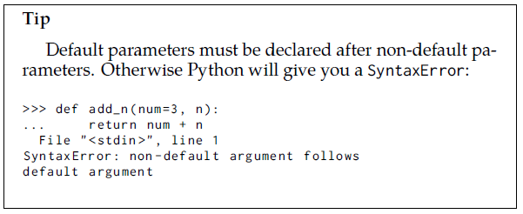
Python Functions - Function Parameters :
Default Parameters
Default parameters allow you to specify the default values for function parameters. The default parameters are then optional, though you can override them if you need.
>>> def add_n (num , n =3):
... """ default to
... adding 3"""
... return num + n
>>> add_n (2)
5
>>> add_n (15 , -5)
10

Slide 47
New slide.
Python Functions - Function Parameters :
Default Parameters
A positional argument cannot follow a keyword argument.
Example: Consider the function definition,
def Display(num1,num2):
Thus, a programmer can invoke the above Display() function as:
Display(40,num2=10)
But, he/she cannot invoke the function as:
Display(num2=10,40)
because the positional argument 40 appears after the keyword argument num2=10.

Slide 48
New slide.
Python Functions - Function Parameters :
Default Parameters
A programmer cannot duplicate an argument by specifying it as both, a positional argument and a keyword argument.
Example: Consider the function definition,
def Display(num1,num2):
Thus, a programmer cannot invoke the above Display() function as
Display(40,num1=40) #Error
because he/she has specified multiple values for parameter num1.

Slide 49
Python Functions - Function Parameters :
Multiple Parameter Functions
def greeter(name, message = 'Live Long and Prosper'):
print('Welcome', name, '-', message)
greeter('Eloise')
greeter('Eloise', 'Hope you like Python')
Output :
Welcome Eloise - Live Long and Prosper
Welcome Eloise - Hope you like Python
Notes:
As you can see from this in the first example (where only one argument was provided) the default message was used.
However, in the second example where a message was provided, along with the name, then that message was used instead of the default.

Slide 50
Python Functions - Function Parameters :
Multiple Parameter Functions
For example, we could not define the greeter function as
def greeter(message = 'Live Long and Prosper', name):
print('Welcome', name, '-', message)
Important note :
As this would generate an error indicating that name must have a default value as it comes after (to the right) of a parameter with a default value.

Slide 51
Python Functions - Function Parameters :
Multiple Parameter Functions
Note we can use the terms mandatory and optional for the parameters in greeter(). In this case
• name is a mandatory field/parameter
• message is an optional field/parameter (as it has a default value).
One subtle point to note is that any number of parameters in a function’s parameter list can have a default value; however once one parameter has a default value all remaining parameters to the right of that parameter must also have default values.
For example, we could not define the greeter function as
As this would generate an error indicating that name must have a default value
as it comes after (to the right) of a parameter with a default value.

Slide 52
Python Functions :
Basic Functions
A function is a reusable piece of code that is only run when it is called. Functions can have inputs, and they usually return an output. For example, using a Python shell, you can define the following function that takes two inputs and returns the sum:
def add_up(x, y):
return x + y
add_up(1, 3)
You should get the following output:
4

Slide 53
Python Functions :
Calling a Function
    def product(num1, num2):
    prod= num1*num2
    print('The product of the numbers is \t:'+str(prod))
The name of this function is product. It takes two arguments as input (num1 and num2), calculates the product and displays the results.
The function can be invoked as follows:
    num1=int(input('Enter the first number\t:'))
    num2=int(input('Enter the second number\t:'))
    print('Calling the function...')
    product(num1, num2)
    print('Back to the calling function');

Slide 54
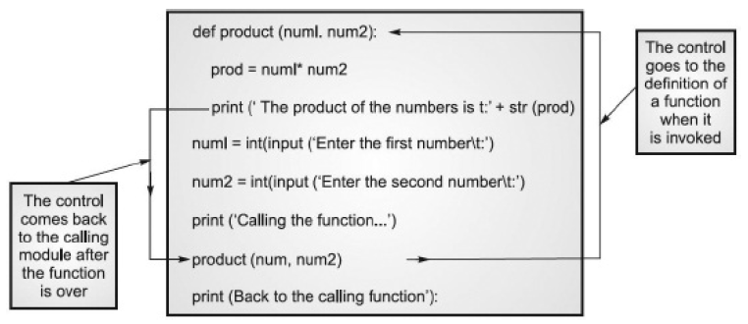
Python Functions :
Calling a Function
xx
<< Exercise A43 >>
<< Exercise A42 >>
<< Exercise A44 >>
Notes:
Here calling product shifts the control to the function, inside which the product is calculated and the result is displayed. The control then comes back to the calling function

Slide 55
Python Functions
Parameters

Slide 56
Python Functions :
Positional Parameters
The preceding examples have all included positional arguments. In the following example, there are two positional arguments, x and y, respectively. When you call this function, the first value you pass in will be assigned to x, and the second value will be assigned to y:
    def add_up(x, y):
    return x + y

Slide 57
Python Functions :
Defining functions with positional parameters
    def prod(sequence):
    p= 1
    for item in sequence:
    p *= item
    return p
    >>> prod([1,2,3,4])
    24
    >>> prod(range(1,6))
    120

Slide 58
Python Functions :
Positional Parameters
You can also specify functions without any arguments:
    from datetime import datetime
    def get_the_time():
    return datetime.now()
    print(get_the_time())
You should get the following output:
Figure 3.19: The current date and time

Slide 59
Python Functions :
Keyword Arguments / Named Arguments
Keyword arguments, also known as named arguments, are optional inputs to functions.
These arguments have a default value that is taken when the function is called without the keyword argument specified.

Slide 60
Python Functions - Function Parameters :
Named Arguments/ Parameters
def greeter(name,
title = 'Dr',
prompt = 'Welcome',
message = 'Live Long and Prosper'):
print(prompt, title, name, '-', message)
greeter(message = 'We like Python', name = 'Lloyd')
Output :
Welcome Dr Lloyd - We like Python

Slide 61
Python Functions - Function Parameters :
Named Arguments/ Parameters
greeter('Lloyd', message = 'We like Python')
Here 'Lloyd' is bound to the name parameter as it is the first parameter, but 'We like Python' is bound to message parameter as it is a named argument.
However, you cannot place positional arguments after a named argument → this will result in Python generating an error. So we cannot write:
greeter(name='John', 'We like Python')

Slide 62
Python Functions - Function Parameters :
Defining Multiple Parameters
Python offers us a variety of ways to assign values to parameters. In the simplest case, the argument values are assigned to the parameters based on position.
def main_sail_area(boom, mast):
return (boom*mast)/1.8
>>> main_sail_area(15, 45)
375.0
<< Activity C05xx >>

Slide 63
New slide
Python Functions - Function Parameters :
Parameters Passing
If you pass a mutable object into a method, the method gets a reference to that same object and you can mutate/change it to your heart's delight, but if you rebind the reference in the method, the outer scope will know nothing about it, and after you're done, the outer reference will still point at the original object.
If you pass an immutable object to a method, you still can't rebind the outer reference, and you can't even mutate/change the object.
mutable object → List , Set, Dict, custom classes,
immutable object → Objects with built-in types ,…(eg int, float, boolean, str, tuple, unicode) are immutable.

Slide 64
Python Functions - Function Parameters :
Parameters Passing – An Example
List is a mutable type.
Let's try to modify the list that was passed to a method:
def try_to_change_list_contents(the_list):
print('got', the_list)
the_list.append('four')
print('changed to', the_list)
outer_list = ['one', 'two', 'three']
print('before, outer_list =', outer_list) try_to_change_list_contents(outer_list)
print('after, outer_list =', outer_list)

Slide 65
Python Functions - Function Parameters :
Parameters Passing – An Example
Output :
before, outer_list = ['one', 'two', 'three']
got ['one', 'two', 'three']
changed to ['one', 'two', 'three', 'four']
after, outer_list = ['one', 'two', 'three', 'four']
List is a mutable type.
Let's try to modify the list that was passed to a method:
def try_to_change_list_contents(the_list):
print('got', the_list)
the_list.append('four')
print('changed to', the_list)
outer_list = ['one', 'two', 'three']
print('before, outer_list =', outer_list) try_to_change_list_contents(outer_list)
print('after, outer_list =', outer_list)

Slide 66
Python Functions - Function Parameters :
Parameters Passing – Example 02
def try_to_change_list_reference(the_list):
print('got', the_list)
the_list = ['and', 'we', 'can', 'not', 'lie']
print('set to', the_list)
outer_list = ['we', 'like', 'proper', 'English']
print('before, outer_list =', outer_list) try_to_change_list_reference(outer_list)
print('after, outer_list =', outer_list)
Output :
before, outer_list = ['we', 'like', 'proper', 'English']
got ['we', 'like', 'proper', 'English']
set to ['and', 'we', 'can', 'not', 'lie']
after, outer_list = ['we', 'like', 'proper', 'English']

Slide 67
Python Functions - Function Parameters :
Parameters Passing – Example 03
String - an immutable type. It's immutable, so there's nothing we can do to change the contents of the string.
Now, let's try to change the reference
def try_to_change_string_reference(the_string):
print('got', the_string)
the_string = 'In a kingdom by the sea'
print('set to', the_string)
outer_string = 'It was many and many a year ago'
print('before, outer_string =', outer_string)
try_to_change_string_reference(outer_string)
print('after, outer_string =', outer_string)

Slide 68
Python Functions - Function Parameters :
Parameters Passing – Example 03
Output :
before, outer_string = It was many and many a year ago
got It was many and many a year ago
set to In a kingdom by the sea
after, outer_string = It was many and many a year ago
String - an immutable type. It's immutable, so there's nothing we can do to change the contents of the string.
Now, let's try to change the reference
def try_to_change_string_reference(the_string):
print('got', the_string)
the_string = 'In a kingdom by the sea'
print('set to', the_string)
outer_string = 'It was many and many a year ago'
print('before, outer_string =', outer_string)
try_to_change_string_reference(outer_string)
print('after, outer_string =', outer_string)

Slide 69
Python Functions
Return – Multiple Values
& Lists

Slide 70

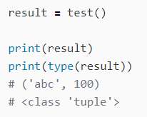
New slide
Python Functions - Function Parameters :
Return Multiple Values
xx
Tuple….without bracket in return-statement
Notes:
In Python, comma-separated values are considered tuples without parentheses.

Slide 71
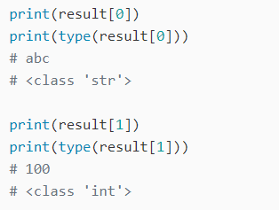

New slide
Python Functions - Function Parameters :
Return Multiple Values
Each element has a type defined in the function.

Slide 72
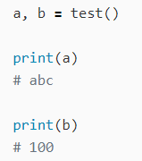
New slide
Python Functions - Function Parameters :
Return Multiple Values
Xx

Slide 73
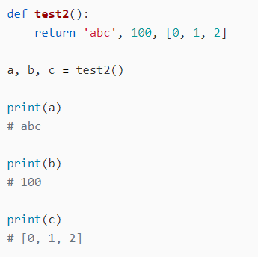
New slide
Python Functions - Function Parameters :
Return Multiple Values
xx

Slide 74
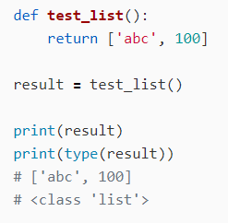
New slide
Python Functions - Function Parameters :
Return List
xx
List….with bracket in return-statement

Slide 75
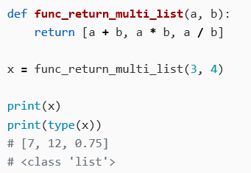
New slide
Python Functions - Function Parameters :
Return List
If you enclose it in [], a list is returned instead of a tuple.

Slide 76
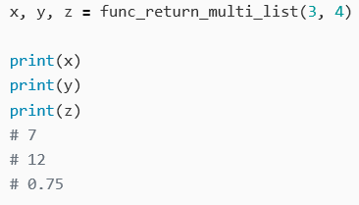
New slide
Python Functions - Function Parameters :
Return List
If you enclose it in [], a list is returned instead of a tuple.
Notes:
The main difference between lists and tuples is the fact that lists are mutable whereas tuples are immutable.

Slide 77
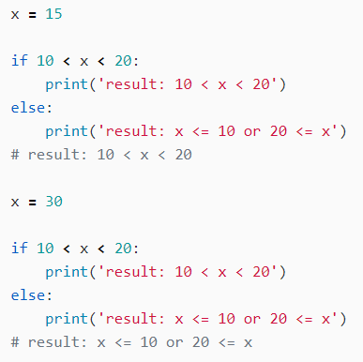
New slide
Python Functions - Function Parameters :
Combined Comparisons
xx

Slide 78
Python Functions
Docstring

Slide 79
Python Functions :
Docstrings
A docstring is a string appearing as the first statement in a script, function, or class. The docstring becomes a special attribute of the object, accessible with __doc__. Docstrings are used to store descriptive information to explain to the user what the code is for, and some high-level information on how they should use it.
Docstring is optional. The docstring allows the function to provide some guidance on what is expected in terms of the data passed into the parameters, potentially what will happen if the data is incorrect,as well as what the purpose of the function is in the first place.
In the following example, the docstring is being used to explain the behaviour of the function and how the parameter is used

Slide 80
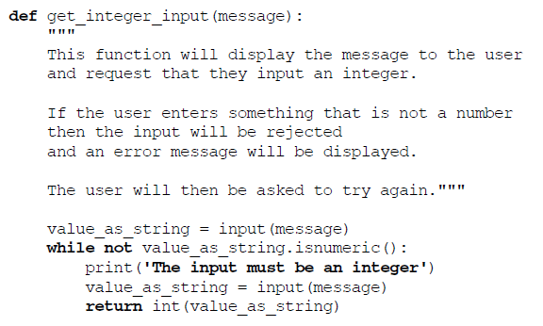
Python Functions :
Docstring
xxx

Slide 81
Python Functions :
Docstring
When used this method will guarantee that a valid integer will be returned to the calling code:
age = get_integer_input('Please input your age: ')
print('age is', age)
An example of what happens when this is run is given below:
Please input your age: John
The input must be an integer
Please input your age: 21
age is 21
<< Exercise A36 >>

Slide 82
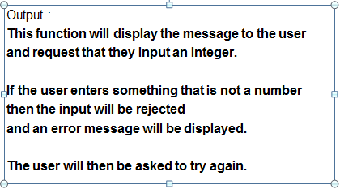
Python Functions :
Docstring
The docstring can be read directly from the code but is also available to IDEs such as PyCharm so that they can provide information about the function. It is even available to the programmer via a very special property of the function called __doc__ that is accessible via the name of the function using the dot notation:
print(get_integer_input.__doc__)

Slide 83
Python Scripts & Modules :
Imports
Python files typically import classes, modules, and functions from other libraries. For example, if you wanted to compute the value of exp(2), you could import the math module from the standard library :
import math
math.exp(2)
You should get the following output:
7.38905609893065

Slide 84
Python Scripts & Modules :
Imports
In the preceding example, you imported the math module and called an exp function that exists within the module. Alternatively, you could import the function itself from the math module:
from math import exp
exp(2)
You should get the following output:
7.38905609893065

Slide 85
Python Scripts & Modules :
Imports
Note that there is a third way of importing, which should generally be avoided unless necessary:
from math import *
exp(2)
You should get the following output:
7.38905609893065
The import * syntax simply imports everything in the module. It is considered undesirable primarily because you end up with references to too many objects, and there's a risk that the names of these objects will clash. It's also harder to see where certain objects are imported from if there are multiple import * statements.

Slide 86
Python Scripts & Modules :
Imports
You can also rename modules or imported objects in the import statement itself:
from math import exp as exponential
exponential(2)
You should get the following output:
7.38905609893065
This is sometimes useful if you simply find the name of the object to be unwieldy, making your code less readable. Or, it could be necessary where you want to use two modules that happen to have the same name.
<< Exercise A37 >>

Slide 87
Python Functions :
Online Resources
See the Python Standard Library documentation for:
• https://docs.python.org/3/library/functions.html for a list of built-in functions in Python.
• https://www.w3schools.com/python/python_functions.asp the W3 Schools brief introduction to Python functions.
• https://www.w3schools.com/python/python_lambda.asp a short summary of lambda functions.
<< Exercise B11 >>

Slide 88

Thank you

